Slide 1
CAA Background Check

Slide 2
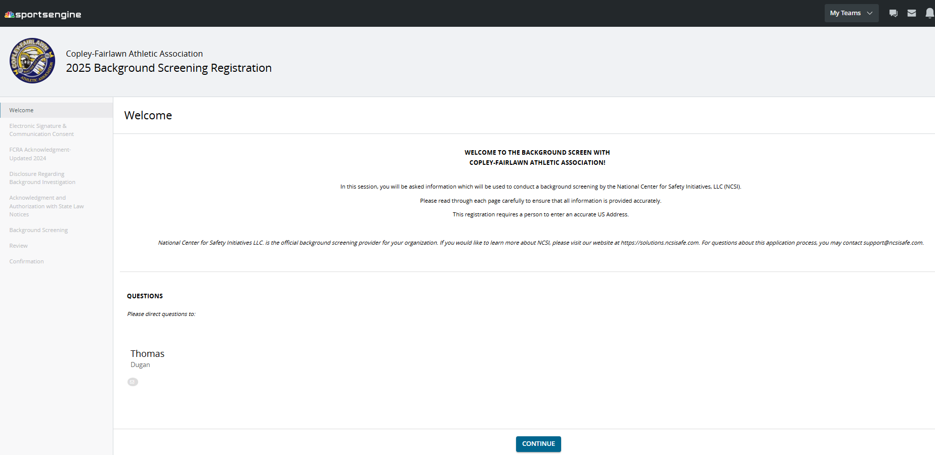
Log on to site
Follow link to site and either logon as existing user or sign up for a new account. You can do 1-background screen per year under your logon.
https://playcaasports.sportngin.com/register/form/860300007

Slide 3
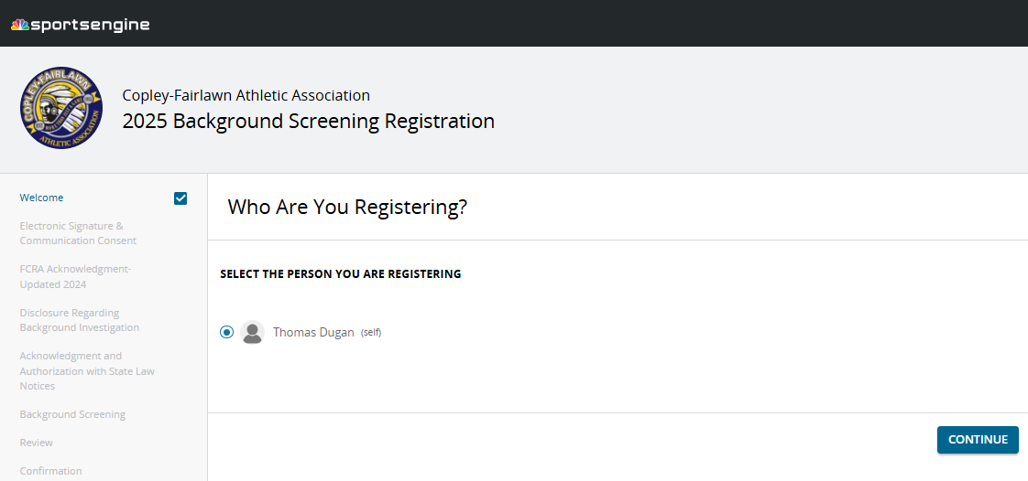
Step 2
After signing up for an account, you will receive an e-mail with a link that will take you to the attached page. Click on the link to be taken to the background check page
Obviously you are registering yourself!

Slide 4
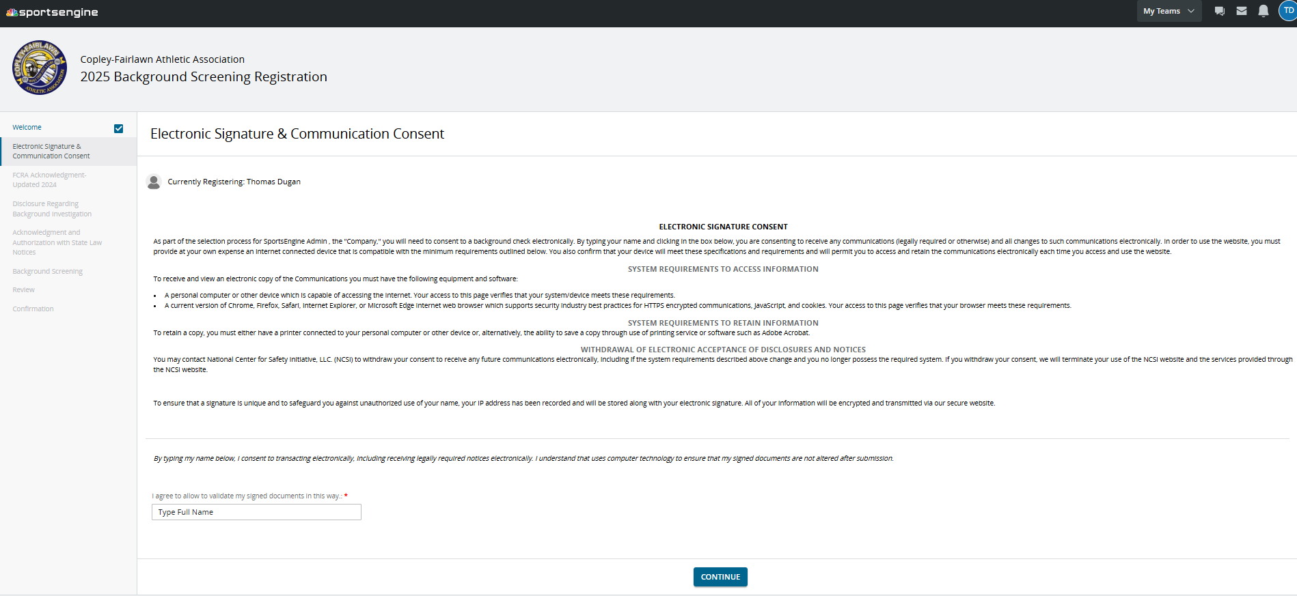
Step 3
All the fun legal disclosures

Slide 5
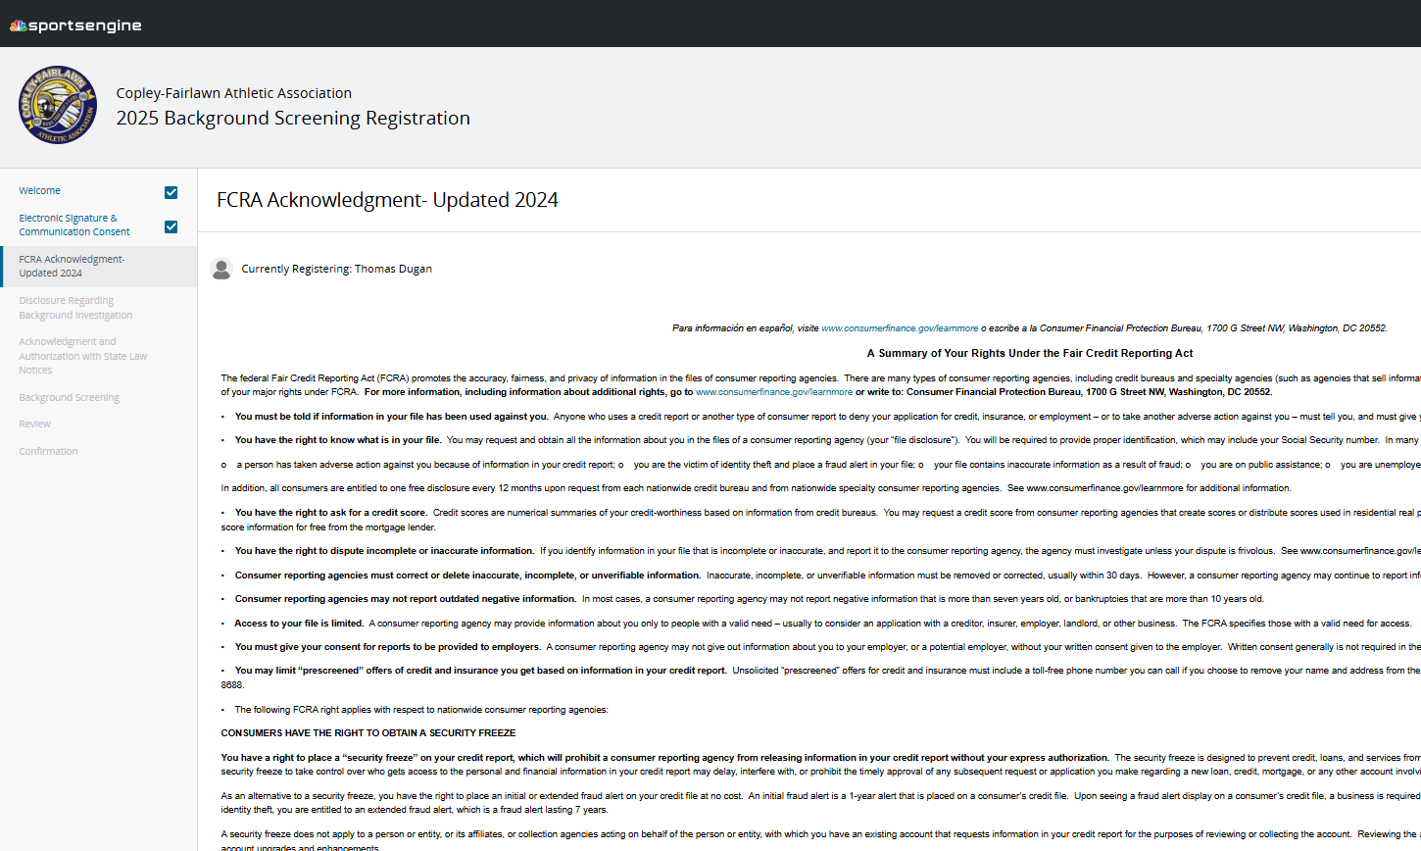
Step 3
More fun legal disclosures

Slide 6
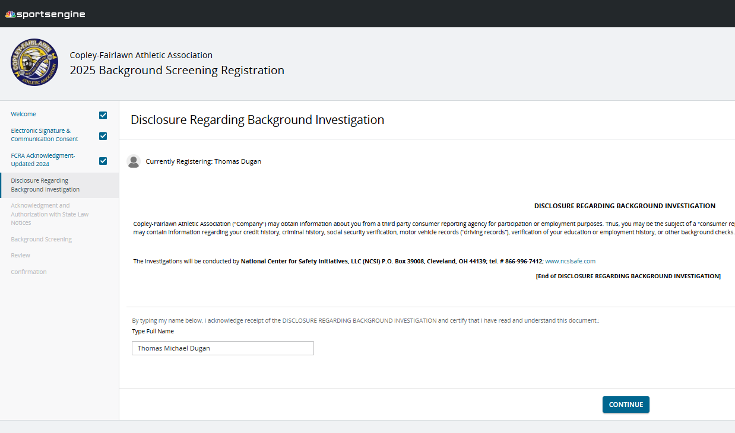
Step 3
And you thought the legal disclosure pages were done – wrong!

Slide 7
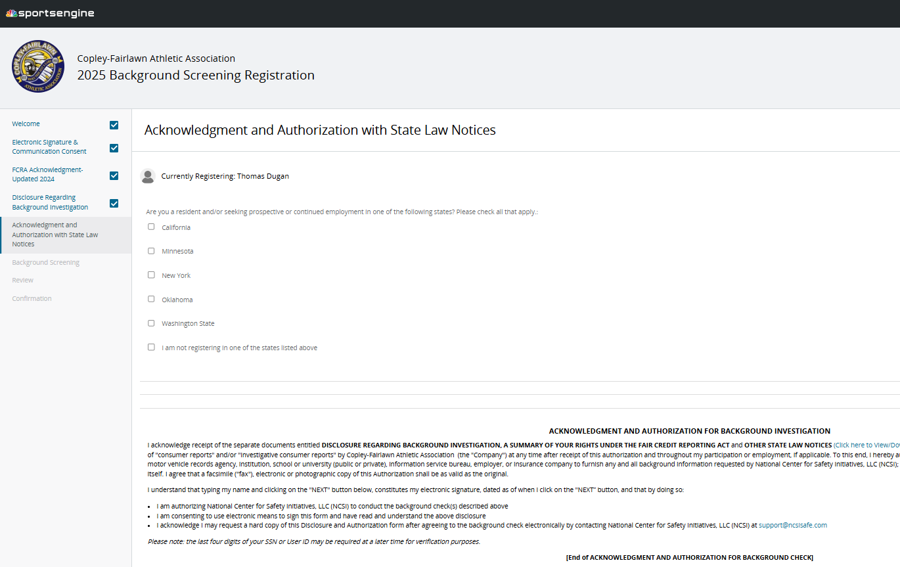
Step 3 – yes, the disclosures just keep coming

Slide 8
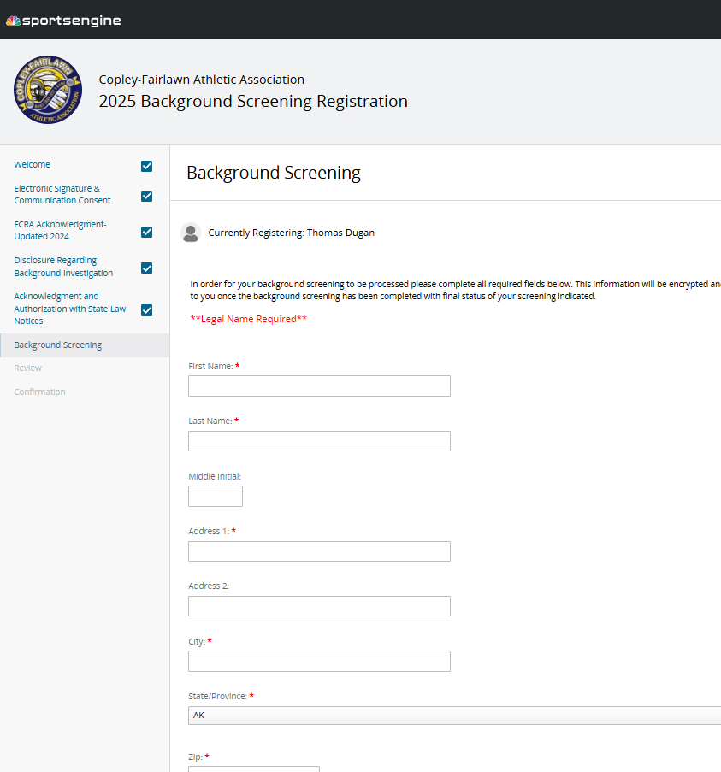
Step 4 – input your information

Slide 9
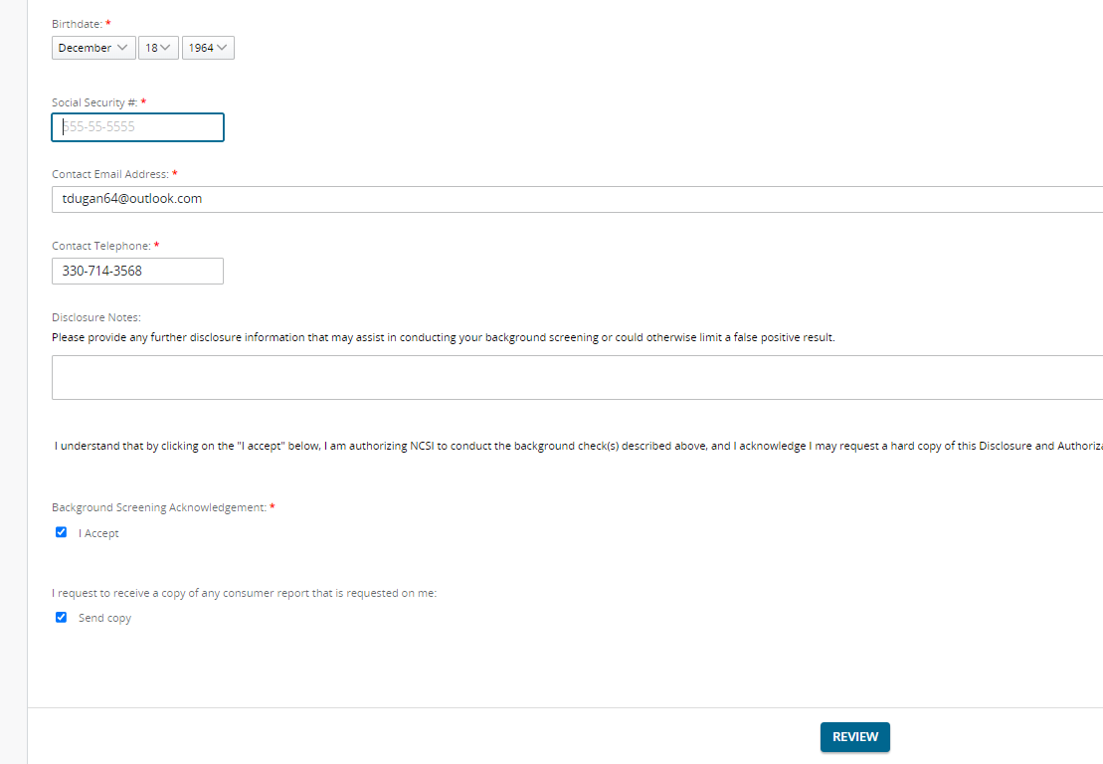
Step 4 – Input, accept and Review
Yes, your information is confidential with Sports Engine. CAA only sees your Name, address, email, phone number and screening results

Slide 10
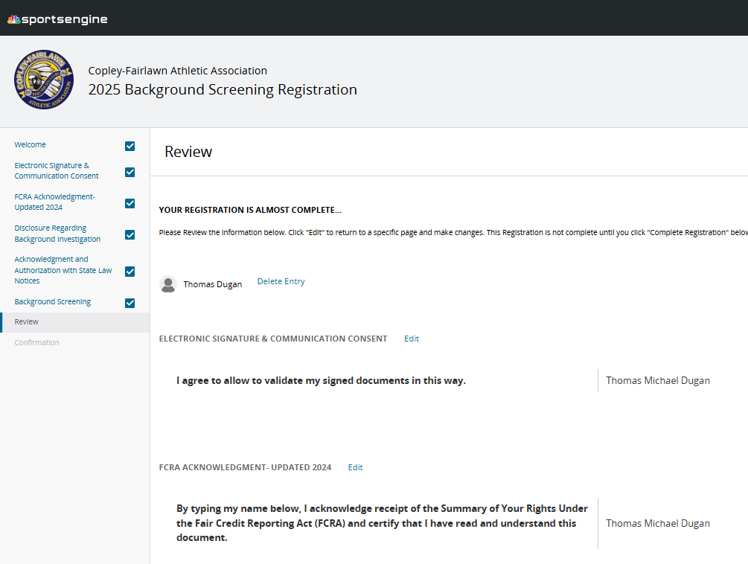
Step 5 – Final Review

Slide 11
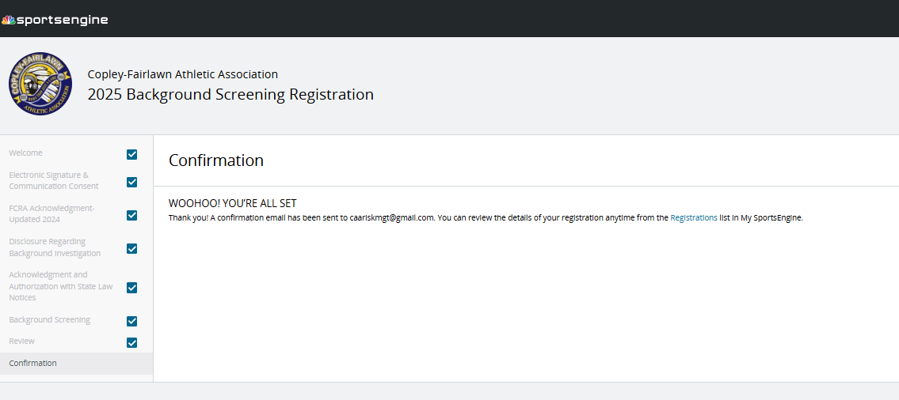
Step 6 – Your Receipt

Slide 12
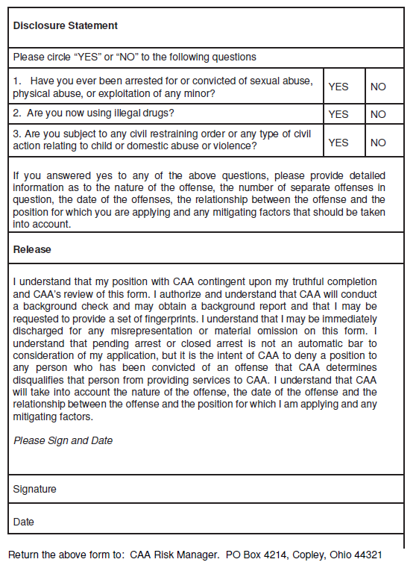
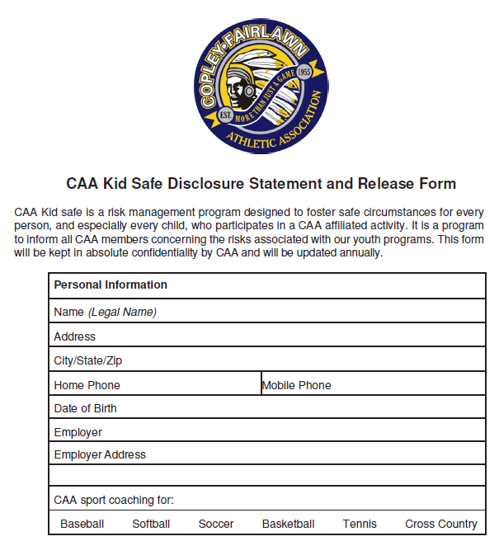
Step 7
Complete and scan back a completed Disclosure form to email or mail it in:
caariskmgt@gmail.com

